Slide 1
Chapter 2: Entity-Relationship Model
Basic Concepts
Constraints
Keys
Design Issues
E-R Diagram

Slide 2
Database Modeling and Implementation Process
Ideas
ER Design
Relational Schema
Relational DBMS
Implementation

Slide 3
Two main activities:
Database design
Applications design
Focus on database design
To design the conceptual schema for a database
Applications design focuses on the programs
interfaces that access the database
Generally considered part of software engineering

Slide 4
Entity Relationship Model (ER Model) is a
popular high-level conceptual data model used for the conceptual design of database
applications.
ER model has three main concepts:
Entities
Attributes
Relationships

Slide 5
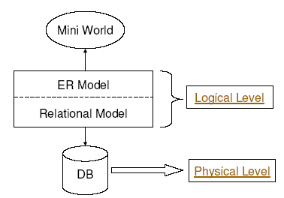

Slide 6

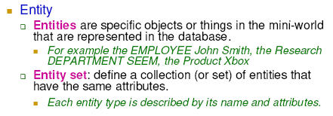

Slide 7
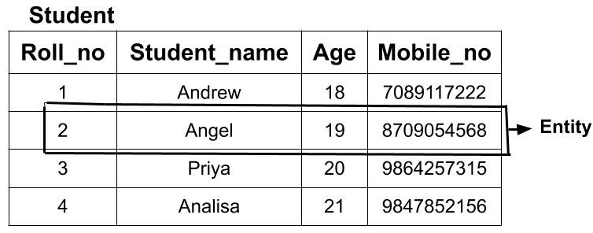

Slide 8

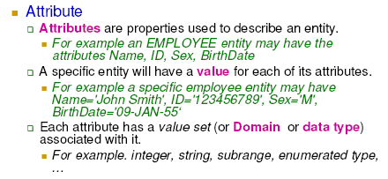

Slide 9

Simple versus composite
Simple (or atomic): Each entity has a single
atomic value for the attribute,
HKID or Sex.
Composite: Composition may form a hierarchy
where some components are themselves composite.
Address(StreetAddress, City, State, Zip) or
Name((FirstName, MiddleName, LastName).

Slide 10
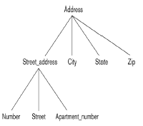

Slide 11
Single-valued versus multivalued
Single-valued: a single value for a particular entity
Age is a single-valued attribute of person.
Multivalued: An entity may have multiple values for that attribute
Colors attribute for a car, or a Previous Degrees attribute for a person. Denoted as {Colors} or {PreviousDegrees}

Slide 12

Stored versus derived
_ For example, the Age and BirthDate attributes of a person. The value of Age can be determined from the current(today’s) date and the value of
that person’s BirthDate.
_ The Age attribute is called a derived attribute. (or be derivable from the BirthDate attribute.)
_ The BirthDate attribute is called a stored attribute.

Slide 13
In general, composite and multi-valued attributes may be nested arbitrarily to any number of levels, although this is rare.
_ For example, PreviousDegrees of a PERSON is a composite multivalued attribute denoted by {PreviousDegrees (College, Year, Degree, Field)}
_ Multiple PreviousDegrees values can exist
_ Each has four subcomponent attributes:_ College, Year, Degree, Field

Slide 14

Null Values: in some cases a particular entity may not have an applicable value for an attribute.
The meaning of Null can be classified into
Not applicable: _ A person with no college degree would have null for College Degree.
Unknown
_ Exists but is missing: If the Height attribute of a person is listed as null.
_ Not known: If the HomePhone attribute of a person is null.
9

Slide 15
Super key: any set of attributes such that the values of the
attributes (taken together) uniquely identify one entity in the
entity set
_ For example, HKID, SID, {NAME, SID}.
_ Candidate key: Minimal super key -- a super key with no
redundant attributes
_ For example, HKID, SID.
_ Primary key: A primary key is one of the candidate keys,
designated by the database designer
_ For example, SID.
_ Every primary key is also a candidate key; every candidate key is also a super key, but not vice versa

Slide 17
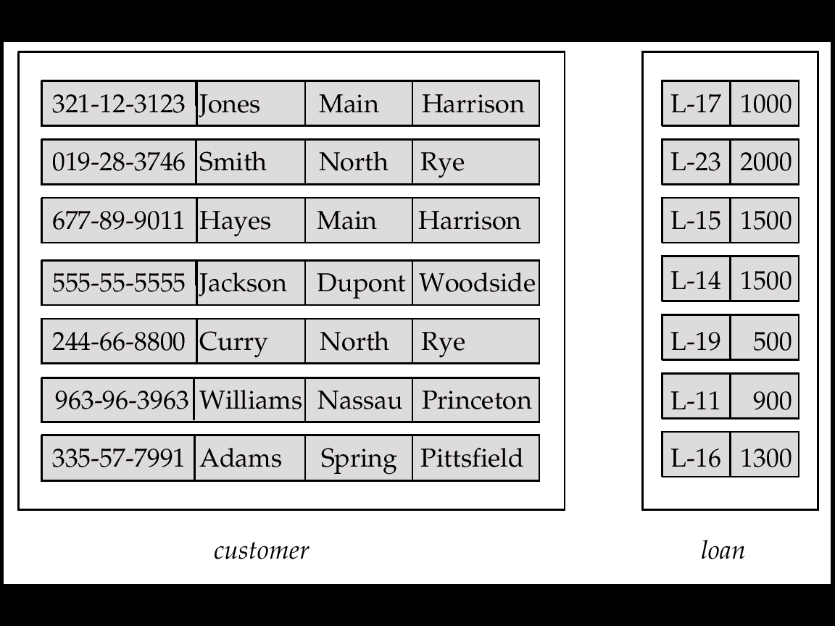
Entity Sets customer and loan
customer-id customer- customer- customer- loan- amount name street city number

Slide 18
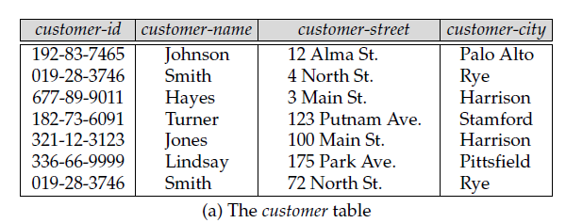
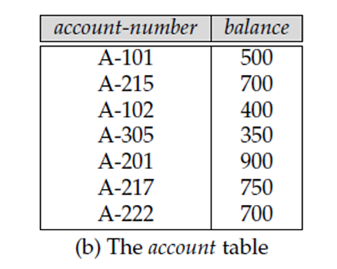

Slide 19
Basic Concepts (Cont.)
Relationship Sets
A relationship is an association among several entities
Example: Hayes depositor A-102 customer entity relationship set account entity
A relationship set is a mathematical relation among n ≥ 2 entities, each taken from entity sets
{(e₁, e₂, … e_{n}) | e₁ ∈ E₁, e₂ ∈ E₂, …, e_{n} ∈ E_{n}} where (e₁, e₂, …, e_{n}) is a relationship

Slide 20
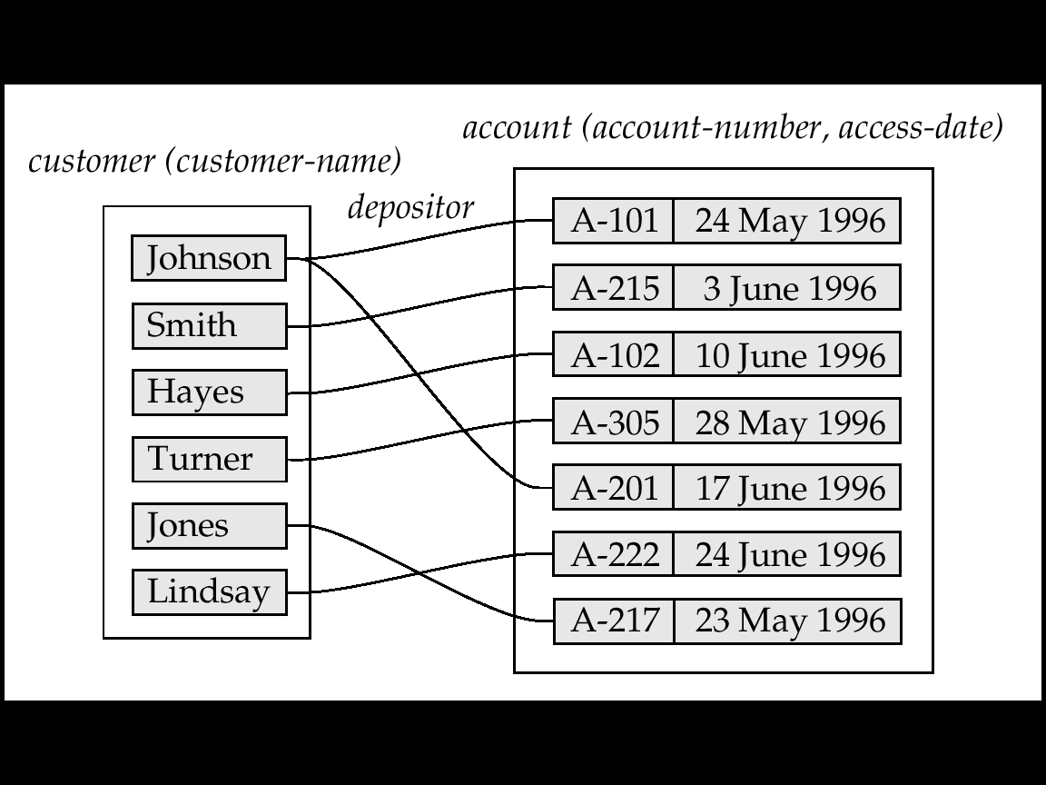
Example: (Hayes, A-102) ∈ depositor

Slide 21
Example: (Hayes, A-102) ∈ depositor

Slide 22
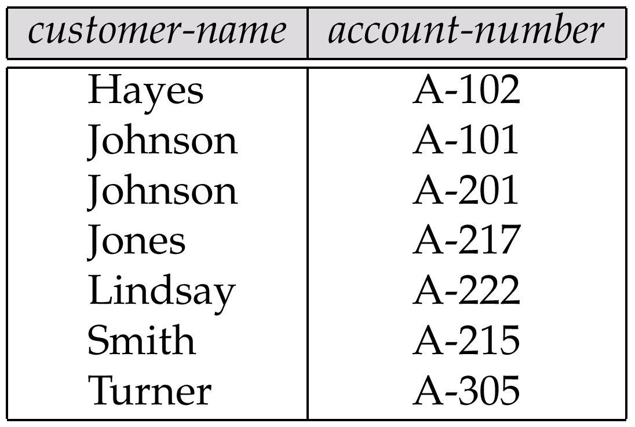
The depositor Relation

Slide 23
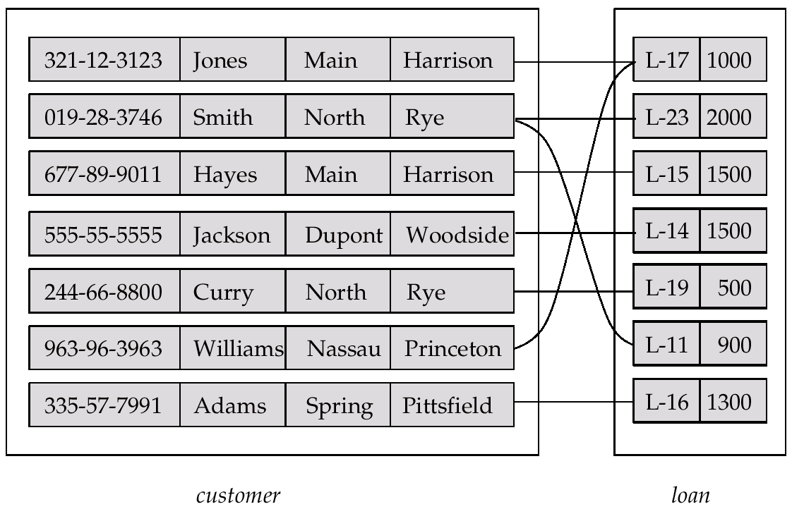
Relationship Set borrower

Slide 24
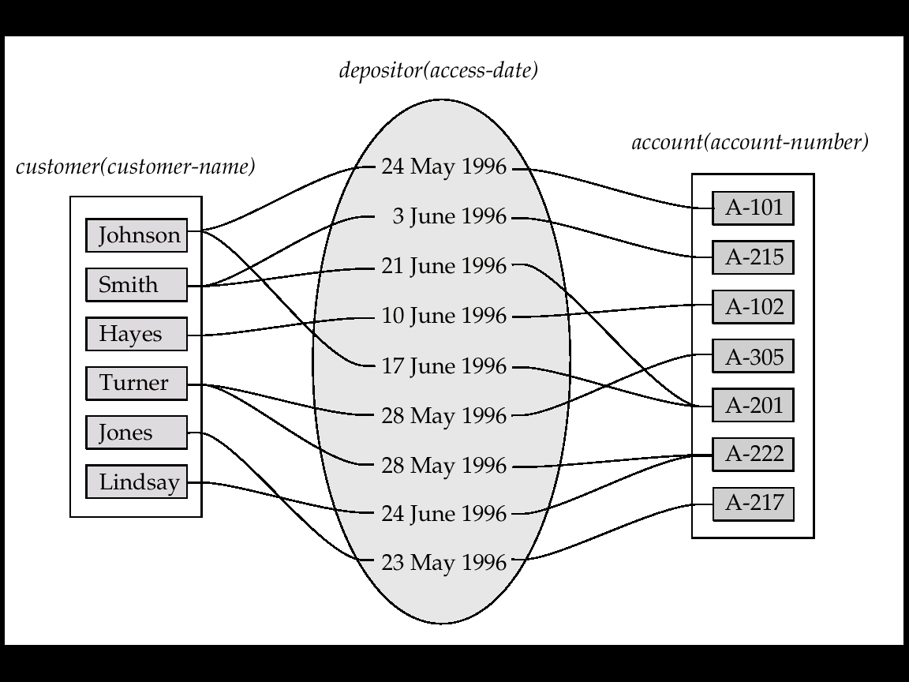
Basic Concepts(Cont.)
An attribute can also be property of a relationship set.
For instance, the depositor relationship set between entity sets customer and account may have the attribute access-date

Slide 25
The association between entity sets is referred to as participation;
that is,
the entity sets E1, E2, . . .,En
participate in relationship set R.

Slide 26
A relationship instance
in an
E-R schema =>
A association between
the named entities in
the real-world enterprise
that is being modeled.

Slide 27
Example
the person called Hayes who
Lives in City Harison
in Main Street
Has taken the loan
Does he have any ID?
Yes, Customer-id 677-89-9011
Any Load Identification?
Yes, Loan is numbered L-15.

Slide 28
Role:
The function that an entity plays in a relationship is called that entity’s role.
Roles are implicit
They are not usually specified.
When Required?
The same entity set participates in a relationship set more than once,

Slide 29
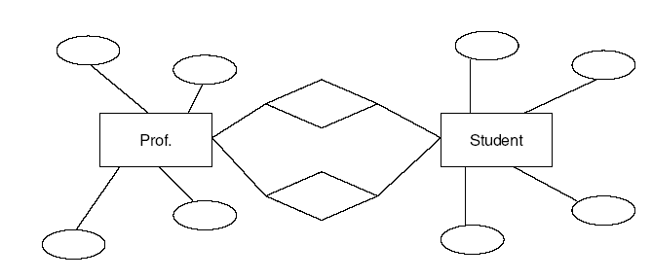
Role: Recursive Relationship
Manager
Employee
Employee
Worker
A relationship Set
works-for
that is modeled by
ordered pairs of employee entities

Slide 30
Basic Concepts(Cont.)
Degree of a Relationship Set
Refers to number of entity sets that participate in a relationship set.
Relationship sets that involve two entity sets are binary (or degree two). Generally, most relationship sets in a database system are binary.
Relationship sets may involve more than two entity sets.
Relationships between more than two entity sets are rare. Most relationships are binary. (More on this later.)
E.g. Suppose employees of a bank may have jobs (responsibilities) at multiple branches, with different jobs at different branches. Then there is a ternary relationship set between entity sets employee, job and branch

Slide 31
Constraints
Mapping Cardinalities
Express the number of entities to which another entity can be associated via a relationship set.
Most useful in describing binary relationship sets.
For a binary relationship set the mapping cardinality must be one of the following types:
One to one
One to many
Many to one
Many to many

Slide 32
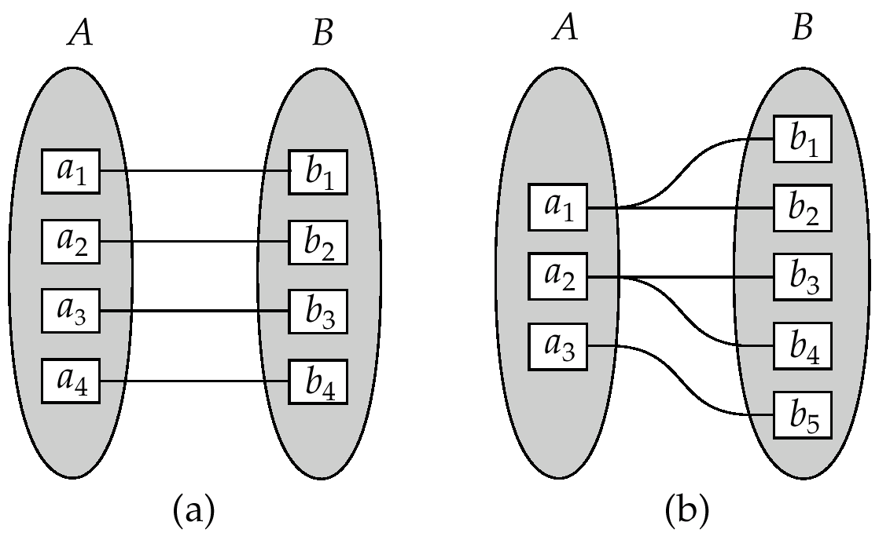
Constraints (Cont.)
One to one
One to many
Note: Some elements in A and B may not be mapped to any
elements in the other set

Slide 33
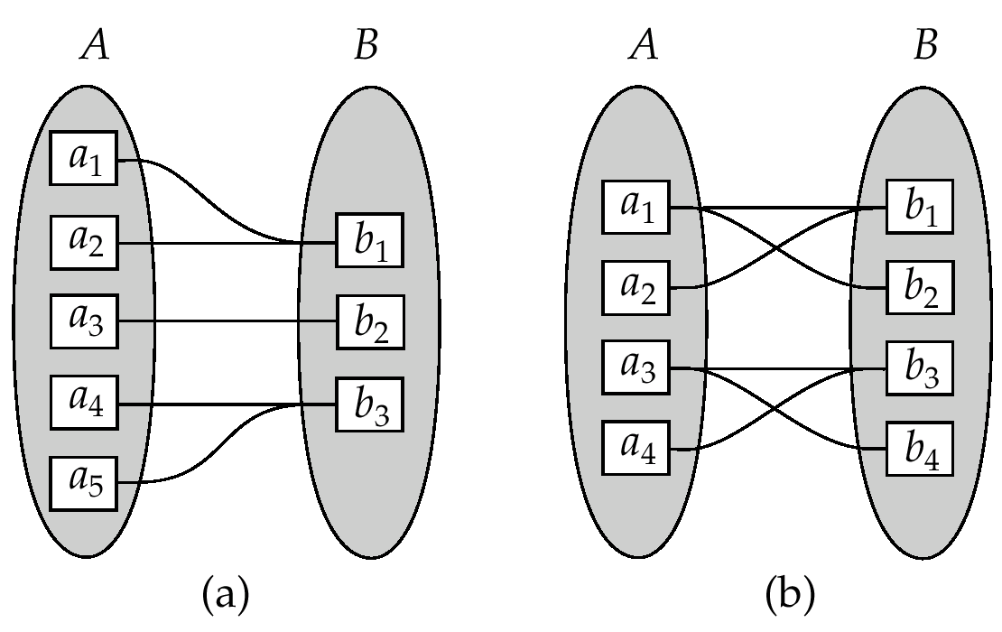
Constraints (Cont.)
Many to one
Many to many
Note: Some elements in A and B may not be mapped to any
elements in the other set

Slide 34
Constraints (Cont.)
Participation Constraints
The participation of an entity set E in a relationship set R is said to be total if every entity in E participates in at least one relationship in R.
For example, we expect every loan entity to be related to at least one customer through the borrower relationship.
If only some entities in E participate in relationship in R, the participation of entity set E in relationship R is said to be partial.
For example, the participation of customer in the borrower relationship set is therefore set is therefore partial.

Slide 35
Keys
Entity Sets
A super key of an entity set is a set of one or more attributes whose values uniquely determine each entity.
A candidate key of an entity set is a minimal super key
Customer-id is candidate key of customer
account-number is candidate key of account
Although several candidate keys may exist, one of the candidate keys is selected to be the primary key.

Slide 36
Relationship Sets
The combination of primary keys of the participating entity sets forms a super key of a relationship set.
primary-key(E1) ∪ primary-key(E2) ∪ · · · ∪ primary-key(En)
describes an individual relationship in set R.
primary-key(E1) ∪ primary-key(E2) ∪ · · · ∪ primary-key(En) ∪ {a1, a2, . . . , am}

Slide 37
Keys (Cont.)
(customer-id, account-number) is the super key of depositor
NOTE: this means a pair of entity sets can have at most one relationship in a particular relationship set.
E.g. if we wish to track all access-dates to each account by each customer, we cannot assume a relationship for each access. We can use a multivalued attribute though
Must consider the mapping cardinality of the relationship set when deciding the what are the candidate keys
Need to consider semantics of relationship set in selecting the primary key in case of more than one candidate key

Slide 38
It is possible
To define a set of entities and the relationships
In a number of different ways

Slide 39
Example:
Case 1:
employee (employee-name, telephone-number)
Case 2:
employee (employee-name)
telephone (telephone-number,location)
Relationship set emp-telephone(association between employees and the telephones that they have)
*An employee may have Multiple/None telephone
Case 3: ?
Employee’s name as an Entity?

Slide 40
Entity Sets versus Attributes
Entity Sets versus Relationship Sets

Slide 41
Entity Sets versus Attributes
What constitutes an attribute, and
what constitutes an entity set?
Unfortunately, there are no simple answers
It depends on:
The structure of the real-world enterprise being modeled
The semantics associated with the attribute in question.

Slide 42
Common Mistakes:
Primary key of an entity set as an attribute of another
entity set.
Example: To model customer-id as an attribute of loan even if each loan had only one customer
To designate the primary key attributes of the related entity sets as attributes of the relationship set

Slide 43
Entity Sets versus Relationship Sets
It is not always clear whether
an object is best expressed by
an entity set
or
a relationship set.

Slide 44
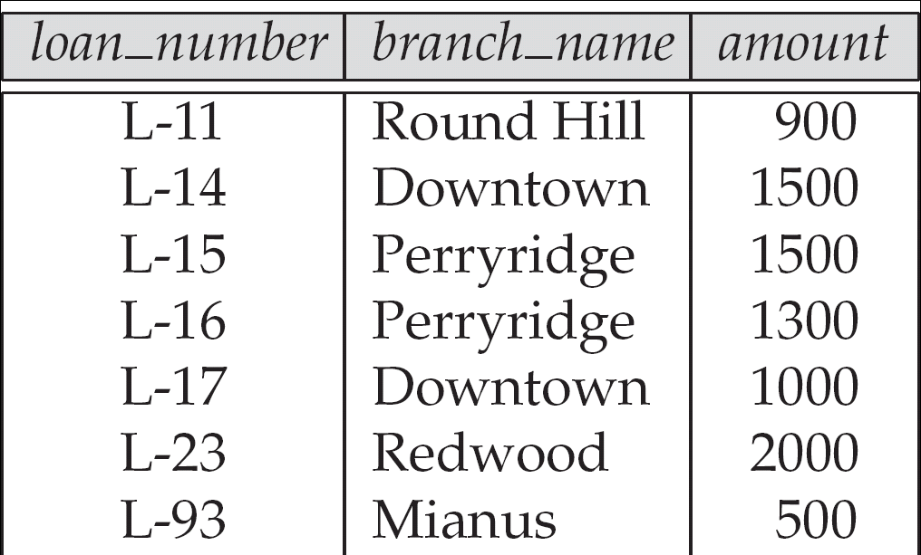
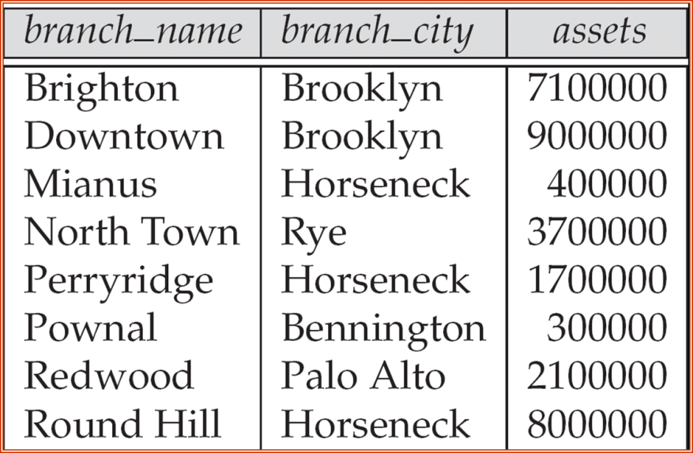

The loan relation

Slide 45
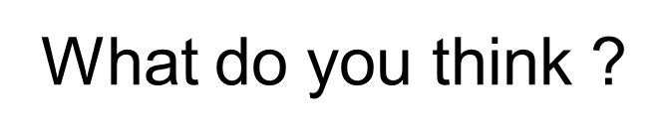
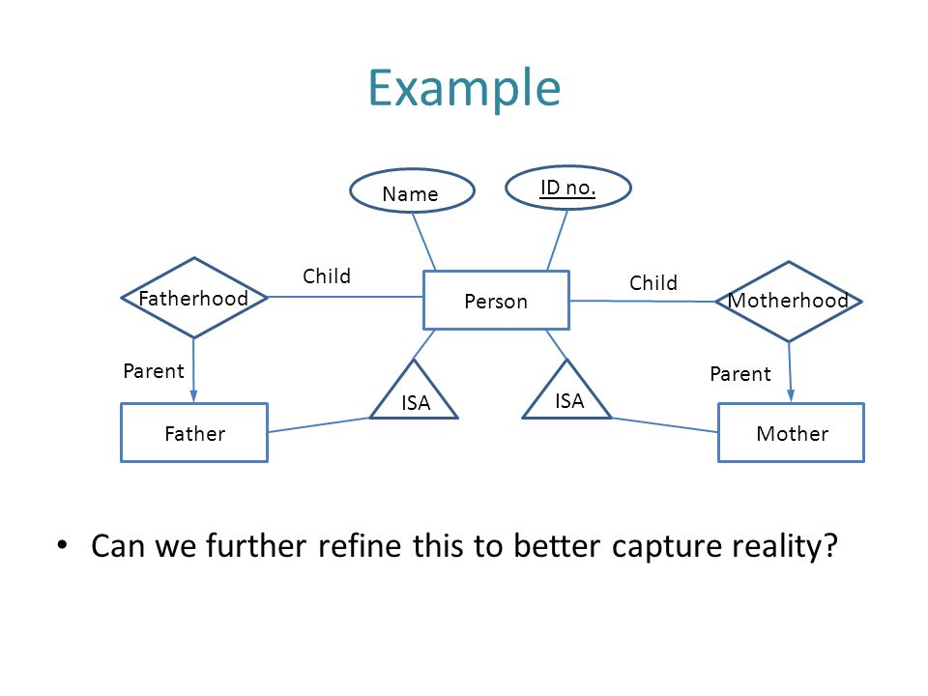

Slide 46
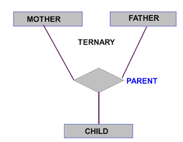

Slide 47

Binary Relationships
If there are two entity types involved it is a binary relationship type

Slide 48

Ternary relationship
If there are three entity types involved it is a ternary relationship type

Slide 49
Replacing ternary relationships
When ternary relationships occurs in an ER model they should always be removed before finishing the model.
Sometimes the relationships can be replaced by a series of binary relationships that link pairs of the original ternary relationship.

Slide 50

Replacing ternary relationships (Cont)
This can result in the loss of some information - It is no longer clear which sales assistant sold a customer a particular product.
Try replacing the ternary relationship with an entity type and a set of binary relationships.

Slide 51

Replacing ternary relationships (Cont)
Relationships are usually verbs, so name the new entity type by the relationship verb rewritten as a noun.
The relationship sells can become the entity type sale.
So a sales assistant can be linked to a specific customer and both of them to the sale of a particular product.
This process also works for higher order relationships.

Slide 52
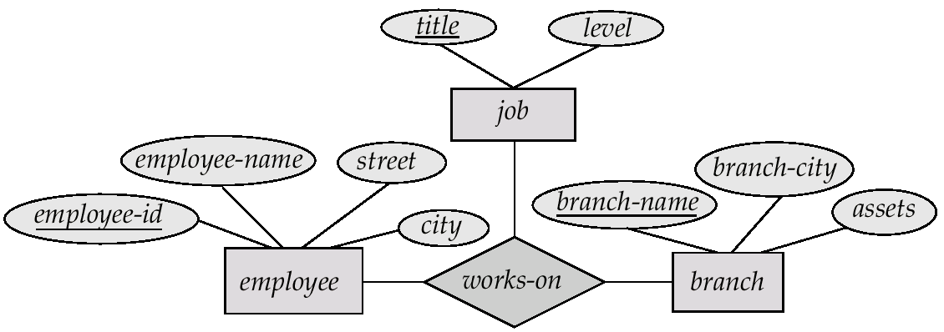
E-R Diagram with a Ternary Relationship

Slide 53
E-R Diagrams
Rectangles represent entity sets.
Diamonds represent relationship sets.
Lines link attributes to entity sets and entity sets to relationship sets.
Ellipses represent attributes
Double ellipses represent multivalued attributes.
Dashed ellipses denote derived attributes.
Underline indicates primary key attributes

Slide 54
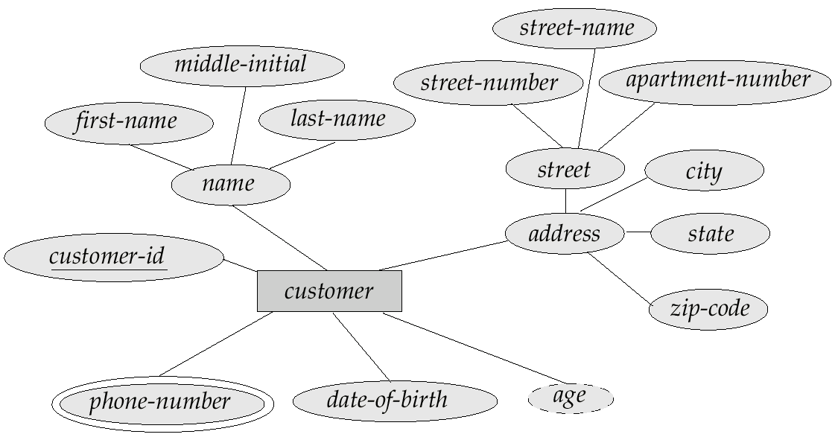
E-R Diagram With Composite, Multivalued, and Derived Attributes

Slide 55
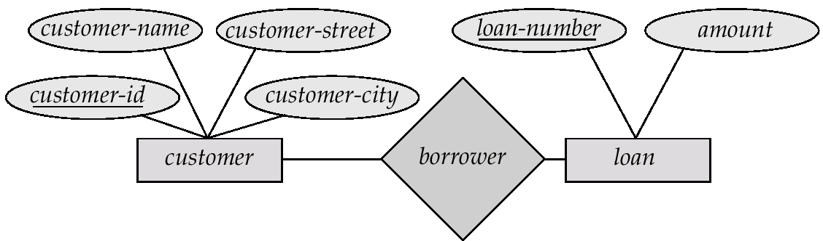
E-R Diagrams many to many
Directed line (Arrow Head) side never be many
A directed line
from the relationship set borrower to the entity set loan
The borrower is either a one-to-one or many-to-one relationship set, from customer to loan;
The borrower cannot be a many-to-many or a one-to-many relationship set from customer to loan.

Slide 56
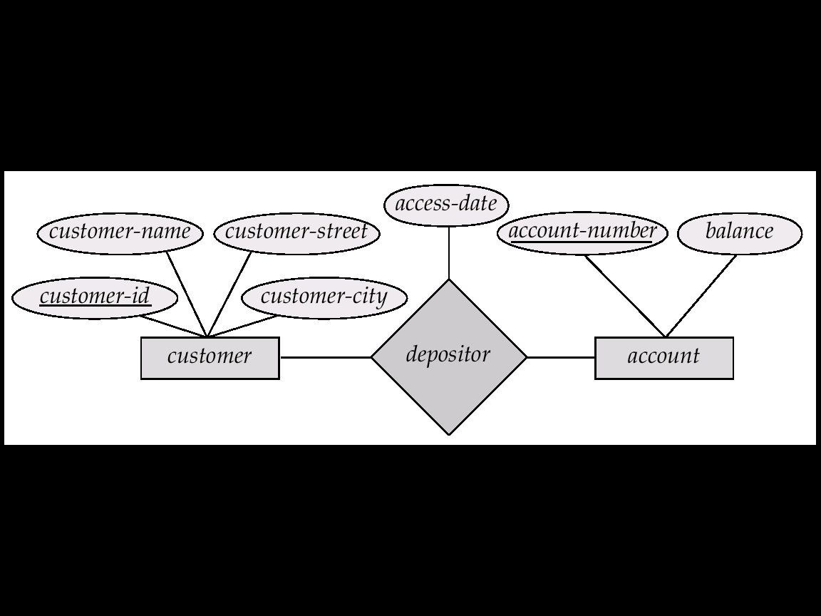
Relationship Sets with Attributes

Slide 57

Degree of a Relationship
It is also possible to have entities associated through two or more distinct relationships.

Slide 58
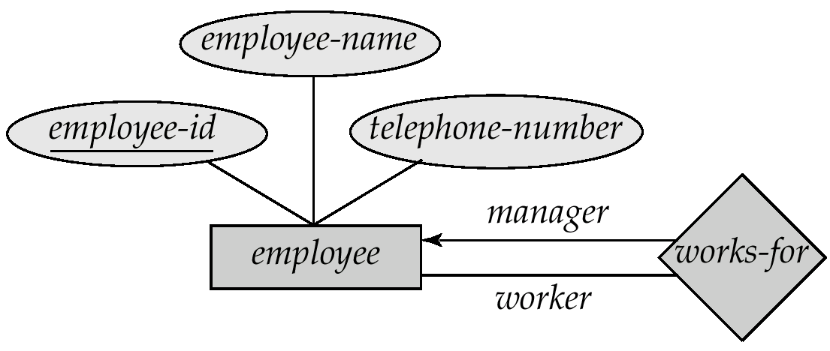
Roles: Degree of a Relationship
The labels “manager” and “worker” are called roles; they specify how employee entities interact via the works-for relationship set.
Roles are indicated in E-R diagrams by labeling the lines that connect diamonds to rectangles.
Role labels are optional, and are used to clarify semantics of the relationship

Slide 59
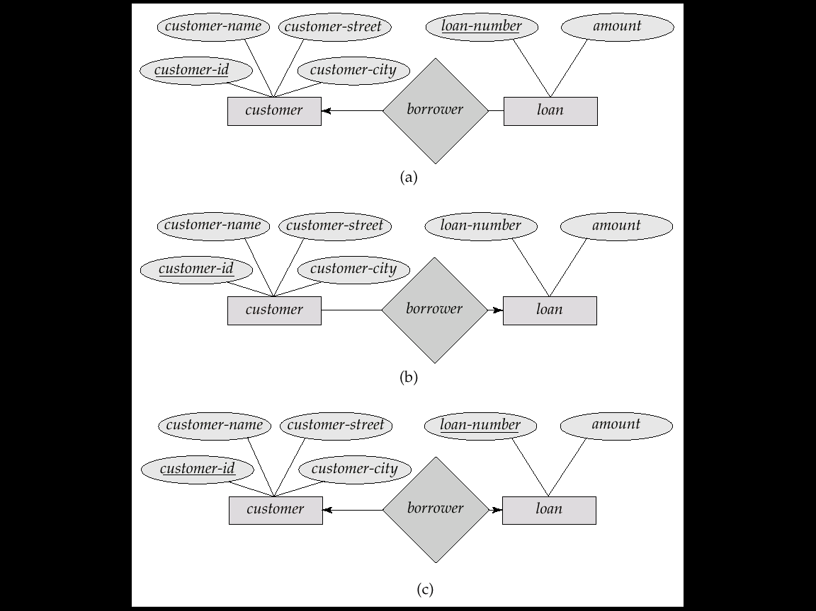
Cardinality Constraints
We express cardinality constraints by drawing either a directed line (→), signifying “one,” or an undirected line (—), signifying “many,” between the relationship set and the entity set.
E.g.: One-to-one relationship:
A customer is associated with at most one loan via the relationship borrower
A loan is associated with at most one customer via borrower

Slide 60

One-To-One Relationship
A man can only marry one woman, and a woman can only marry one man, so it is a one to one (1:1) relationship

Slide 61
One-To-Many Relationship
In the one-to-many relationship a loan is associated with at most one customer via borrower, a customer is associated with several (including 0) loans via borrower

Slide 62

One-To-Many Relationship
One manager manages many employees, but each employee only has one manager, so it is a one to many (1:n) relationship

Slide 63
Many-To-One Relationships
In a many-to-one relationship a loan is associated with several (including 0) customers via borrower, a customer is associated with at most one loan via borrower

Slide 64

Many-To-One Relationships
many students study one course. They do not study more than one course, so it is a many to one (m:1) relationship

Slide 65
Many-To-Many Relationship
A customer is associated with several (possibly 0) loans via borrower
A loan is associated with several (possibly 0) customers via borrower

Slide 66

Many-To-Many Relationship
One lecturer teaches many students and a student is taught by many lecturers, so it is a many to many (m:n) relationship

Slide 67
Deriving the relationship parameters
To check we have the correct parameters (sometimes also known as the degree) of a relationship, ask two questions:
One course is studied by how many students? Answer = `zero or more'
This gives us the degree at the `student' end
The `more' part means that the cardinality is `many
The `zero' part means that the relationship is `optional'. (denoted y ‘O”
If the answer was `one or more', then the relationship would be `mandatory'.
One student studies how many courses? Answer = `One'
This gives us the degree at the `course' end of the relationship.
The answer `one' means that the cardinality of this relationship is 1, and is `mandatory'

Slide 68
Splitting n:m Relationships
A many to many relationship in an ER model is not necessarily incorrect. They can be replaced using an intermediate entity. This should only be done where:
The m:n relationship hides an entity
the resulting ER diagram is easier to understand.
Example: Consider the case of a car hire company.
Customers hire cars
One customer hires many car and
A car is hired by many customers.

Slide 69


Splitting n:m Relationships
The many to many relationship can be broken down to reveal a `hire' entity, which contains an attribute `date of hire'.

Slide 70
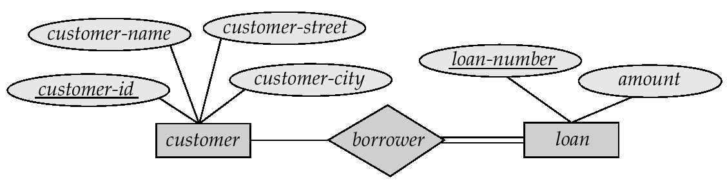
Participation of an Entity Set in a Relationship Set
Total participation (indicated by double line): every entity in the entity set participates in at least one relationship in the relationship set
E.g. participation of loan in borrower is total
every loan must have a customer associated to it via borrower
Partial participation: some entities may not participate in any relationship in the relationship set
E.g. participation of customer in borrower is partial

Slide 71
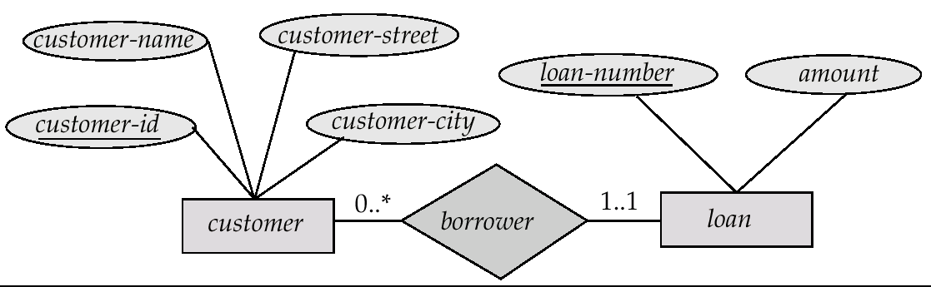
Alternative Notation for Cardinality Limits
Cardinality limits can also express participation constraints

Slide 72
Design Issues
Use of entity sets vs. attributes
A common mistake is to use the primary key of an entity set as another entity set, instead of using a relationship.
Another related mistake that people sometimes make is to designate the primary key attributes of the related entity sets as attributes of the relationship set.

Slide 73
Design Issues (Cont.)
Use of entity sets vs. relationship sets
We assumed that a bank loan is modeled as an entity.
An alternative is to model a loan not as an entity,
but rather as a relationship between customers and branches,
with loan-number and amount as descriptive attributes.

Slide 74
Entity Sets versus Relationship Sets
Example:
Bank loan is modeled as an entity.
An alternative
A loan as a relationship between
customers and branches,
with loan-number and amount as descriptive attributes

Slide 75
Its ok, If,
one customer and is associated with exactly one branch
Bu if happens:
which several customers hold a loan jointly.
We need
A separate relationship for each holder of the joint loan.
To replicate the values for the descriptive attributes loan-number and amount in each

Slide 76
Design Issues (Cont.)
Binary versus n-ary relationship sets Some relationships that appear to be non-binary may be better represented using binary relationships
E.g. A ternary relationship
parents, relating a child to his/her father and mother
is best replaced by two binary relationships, father and mother
Using two binary relationships allows partial information (e.g. only mother being know)

Slide 77
Design Issues (Cont.)
But there are some relationships that are naturally non-binary
E.g. works-on
In general, any non-binary relationship can be represented using binary relationships by creating an artificial entity set.
Replace R between entity sets A, B and C by an entity set E, and three relationship sets:

Slide 78
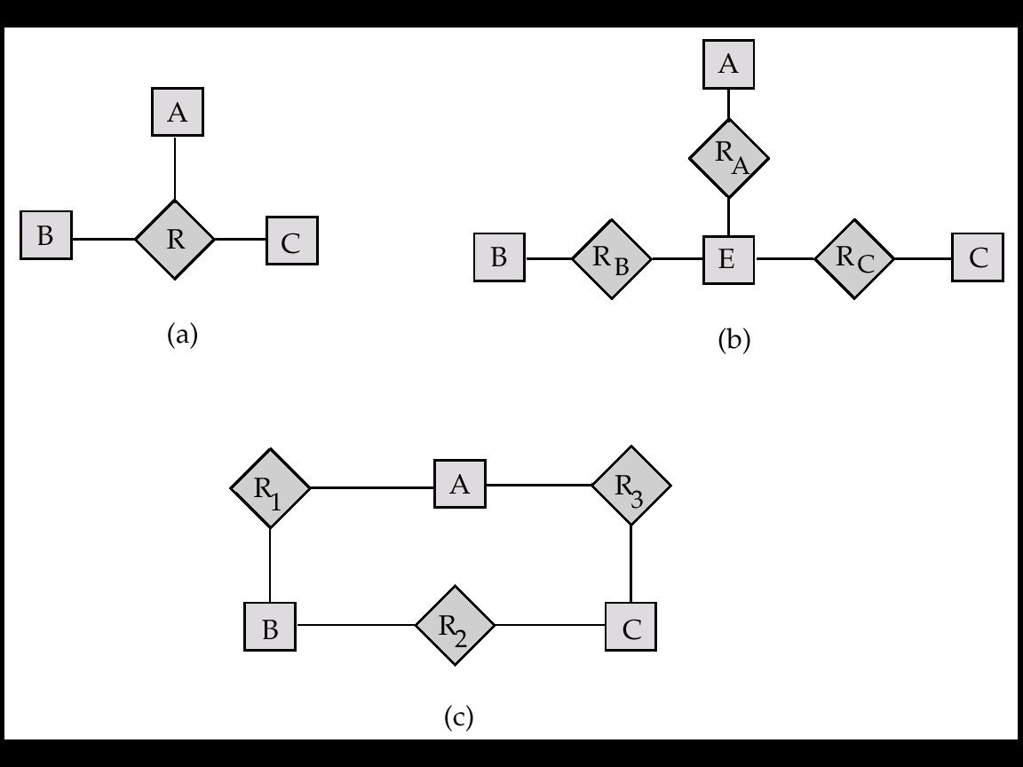
1. R_{A}, relating E and A
2.R_{B}, relating E and B
3. R_{C}, relating E and C
Create a special identifying attribute for E
Add any attributes of R to E
For each relationship (a_{i} , b_{i} , c_{i}) in R, create e_{i}

Slide 79
Design Issues (Cont.)
1. a new entity e_{i} in the entity set E
2. add (e_{i} , a_{i} ) to R_{A}
3. add (e_{i} , b_{i} ) to R_{B}
4. add (e_{i} , c_{i} ) to R_{C}

Slide 80
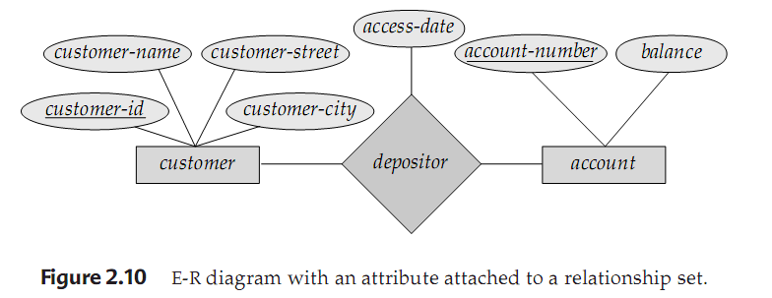
Design Issues (Cont.)
Placement of relationship attributes
Can make access-date an attribute of account, instead of a relationship attribute, if each account can have only one customer
I.e., the relationship from account to customer is many to one, or equivalently, customer to account is one to many

Slide 81
If depositor is a one-to-many relationship
Attribute access-date => customer last accessed that account,
Could be associated with the account entity set
If associated with customer entity
We can’t specify what account was accessed
since customer may have more than one account

Slide 82
Design Issues (Cont.)
Placement of relationship attributes
Can make access-date (customer last accessed that account) an attribute of account, instead of a relationship attribute, if each account can have only one customer
I.e., the relationship from account to customer is many to one, or equivalently, customer to account is one to many

Slide 83
If depositor is a one-to-one relationship
Attribute access-date => customer last accessed that account,
Attribute can be associated with either one of the participating entities

Slide 84
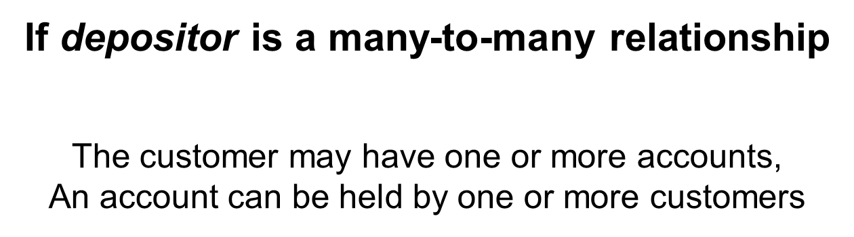
`

Slide 85
If depositor is a many-to-many relationship
To express the date on which a
specific customer last accessed a specific account,
access-date must be an attribute of the depositor relationship
If access-date were an attribute of account,
Unable to determine which customer made the most recent access to a joint account.
If access-date were an attribute of customer entity
We can’t specify what account was accessed
since customer may have more than one account

Slide 86
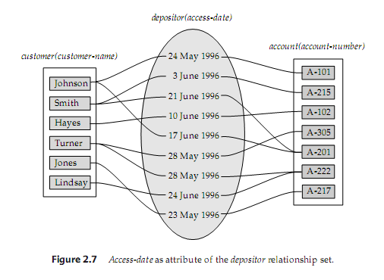

Slide 87
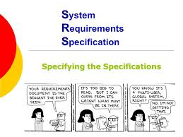

Slide 88

IT Team/DBA/Consultant

